Slide 1
GYM CENTER MEMBERSHIP
Presented by:
Kushal Chapagain
Pramod Jung Khatri
Rupak Sigdel
Sushant Pokharel

Slide 2
Table of Content
Introduction
ER Diagram

Slide 6
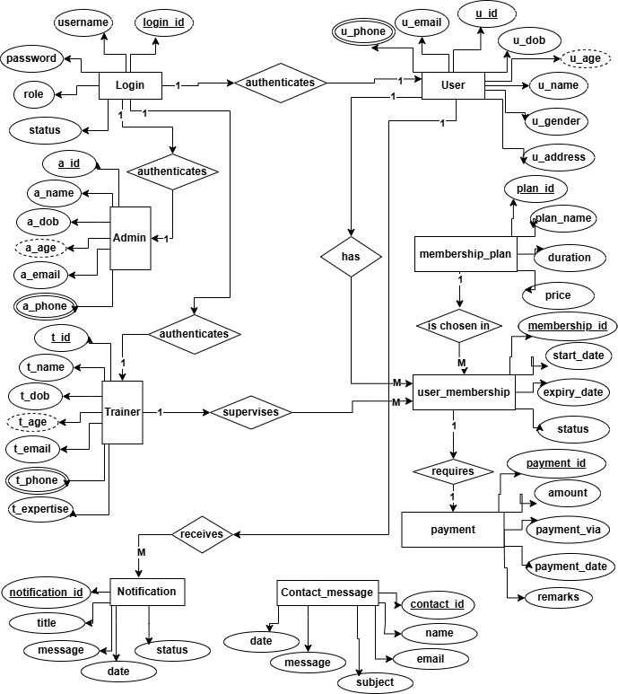
ER DIAGRAM

Slide 7
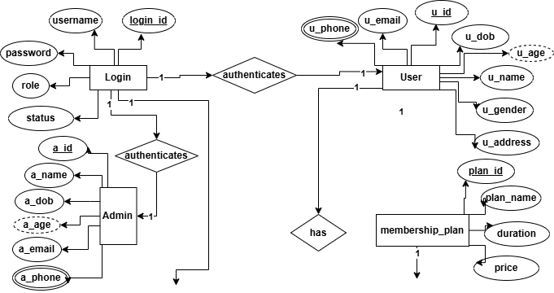
ER DIAGRAM

Slide 8
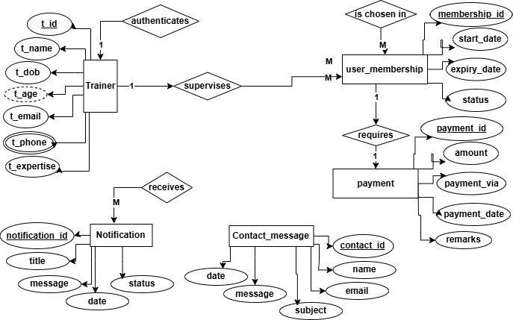
ER DIAGRAM

